Slide 1
2M Thick with old Poly (BL130) to 2M Thick with new Poly (8124ER) Sine Wave HVE Characterization @ 85C & 85%RH
Reliability GROUP
07/07/2016

Slide 2
HVE Testing Details
Test Vehicles:
(Lot #AK15389.7 and DC 1429) → 2M Thick with BL130 Polyimide
(Lot #3355863.1 and DC 1552) → 2M Thick with 8124ER Polyimide
Sine wave HVE Testing
Temp = +85C and 85%RH
Stress Voltages: 3kVac, 2.5kVac, 2.0kVac, 1.5kVac and 1kVac
23 units per stress voltage
Package: 20L SOIC_W
Maximum Continuous Working Voltage Supporting a 50-Year: 400Vrms (per datasheet)

Slide 3
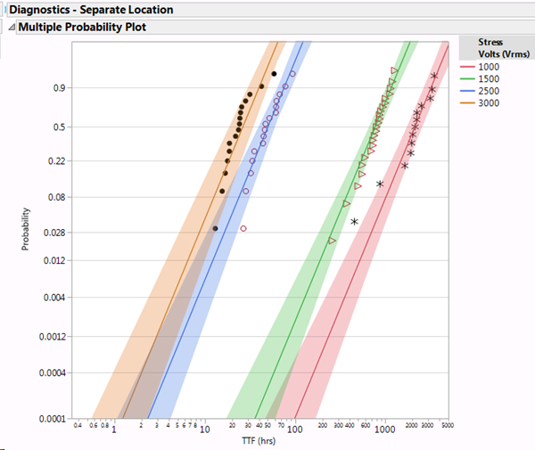
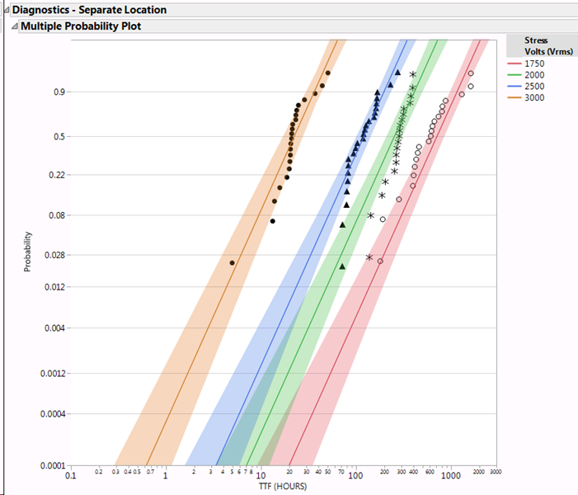
Raw Weibull Distributions
Old Polyimide BL130
New Polyimide 8124ER

Slide 4
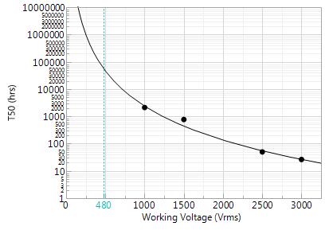
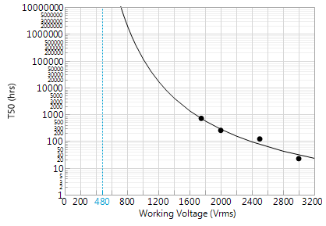
T50 Lifetime Curve (1/Y² Weight)
Old Polyimide BL130
New Polyimide 8124ER

Slide 5
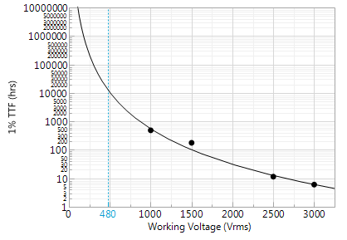
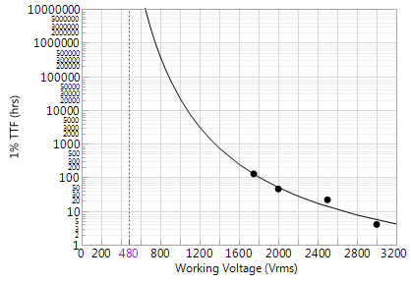
1% TTF Lifetime Curve (1/Y² Weight)
Old Polyimide BL130
New Polyimide 8124ER

Slide 6
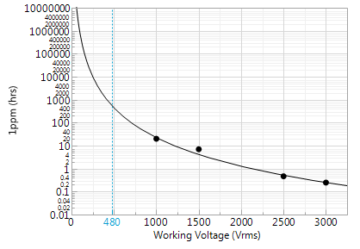
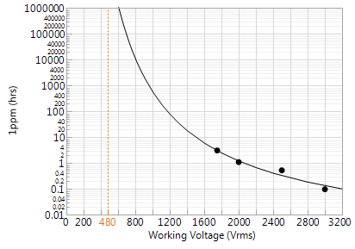
1ppm Lifetime Curve (1/Y² Weight)
Old Polyimide BL130
New Polyimide 8124ER

Slide 7
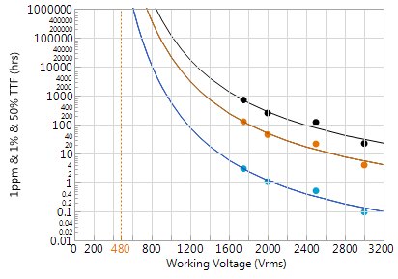
New Polyimide 8124ER – Combined Lifetime Curves

